Slide 1

IEC 61400-12-1 FDIS 2016 Worked Example Industrial Project
8th September 2016
Pamplona, Spain
Andrew Lawrence & Lee Cameron

Slide 2



PCWG Industrial Placement
The first PCWG Industrial Placement was completed by Andrew Lawrence of Cambridge University during July and August 2016.
The placement was sponsored by SSE, RES & Senvion.
The placement was hosted at RES’s office Kings Langley and managed by Lee Cameron (RES).
Andrew was tasked with completing a set of work examples of the uncertainty methodology of the new IEC 61400-12-1 standard.
This project is intended to be complimentary to the IEA Task 32 Uncertainty Round Robin
Many thanks to our supporting members who made this industrial placement possible

Slide 3
IEC 61400-12-1 Status
Document Stage | Document Stage Description | IEC61400-12-1 Ed 2 Status
CDV Committee Draft for Voting | Feedback Stage: Document is sent to the various National Committees for comment. Once the feedback is received the TC (Technical Committee) integrated the feedback and prepares the FDIS. | Completed
FDIS Final Draft International Standard | Approval Stage: Document is sent to the National Committees for voting. At this stage no comments or requests for change are accepted although typographical errors can be pointed out for correction by IEC prior to publication. If, after the FDIS vote, the publication is approved, no more changes of a technical nature can be made to it. Only obvious editorial mistakes can be corrected. | Translation of FDIS to French presently in progress to be followed by issue of English/French FDIS to national committees for voting mid-August to October.
Publication of IS (International Standard) | Final Stage: The IEC generates the cover pages and prepares the document for publication. The document is published and put on sale in the IEC Web Store. Note that editorial errors not captured prior to publication can still be issued as corrigendum by IEC throughout the life of a specific publication. | Expected Late 2016/Early 2017
For a useful overview of the lifecycle of an IEC standard see http://www.iec.ch/standardsdev/resources/draftingpublications/overview/drafting_process/lifecycle.htm

Slide 4
IEC Task 32 & PCWG Collaboration Overview
The PCWG & IEA Task 32 are collaborating on a round robin exercise and associated set of spreadsheet worked examples.
IEC Task 32 is running a round robin on the application of IEC61400-12-1 Ed 2 using LiDAR data. The round robin will have particular focus on the uncertainty methodology of the new standard (informative Annex E).
The PCWG is seeking to develop a set of worked examples showing how to apply the uncertainty method defined in the new standard. Once complete these worked examples will serve as both an educational tool and as a benchmark for the PCWG analysis tool.
Expected Outcome: The combination of the round robin and supporting work examples are intended to build industry understanding and consensus of the new edition of IEC 61400-12-1.

Slide 5
Proposed Timeline (2016)
Round Robin (IEA Task 32)
Worked Examples (PCWG)
July and August: Distribute round robin dataset and instructions to registered participants.
01 September: Results due to be summarized and presented at PCWG meeting on 07 September in Pamplona
September: Present a summary of results and then investigate differences and identify clarifications to be provided in a second exercise, if justified.
October: Request second round robin be conducted, results due by end of month.
November: Collect final results, prepare summaries for PCWG meeting in Glasgow week of 12 December.
December: Presentation of final results at December PCWG meeting.
July & August: Preparation of work examples. Initial presentation of examples at August PCWG Meeting.
September: Preparation of full suite of worked examples at September PCWG Meeting. Release of worked examples on PCWG DropBox.
October & November: IEA32 & PCWG feedback on worked examples.
December: Public publication of work examples (ww.pcwg.org)

Slide 6
IEC 61400-12-1 FDIS 2016 Worked Example Industrial Project

Slide 7
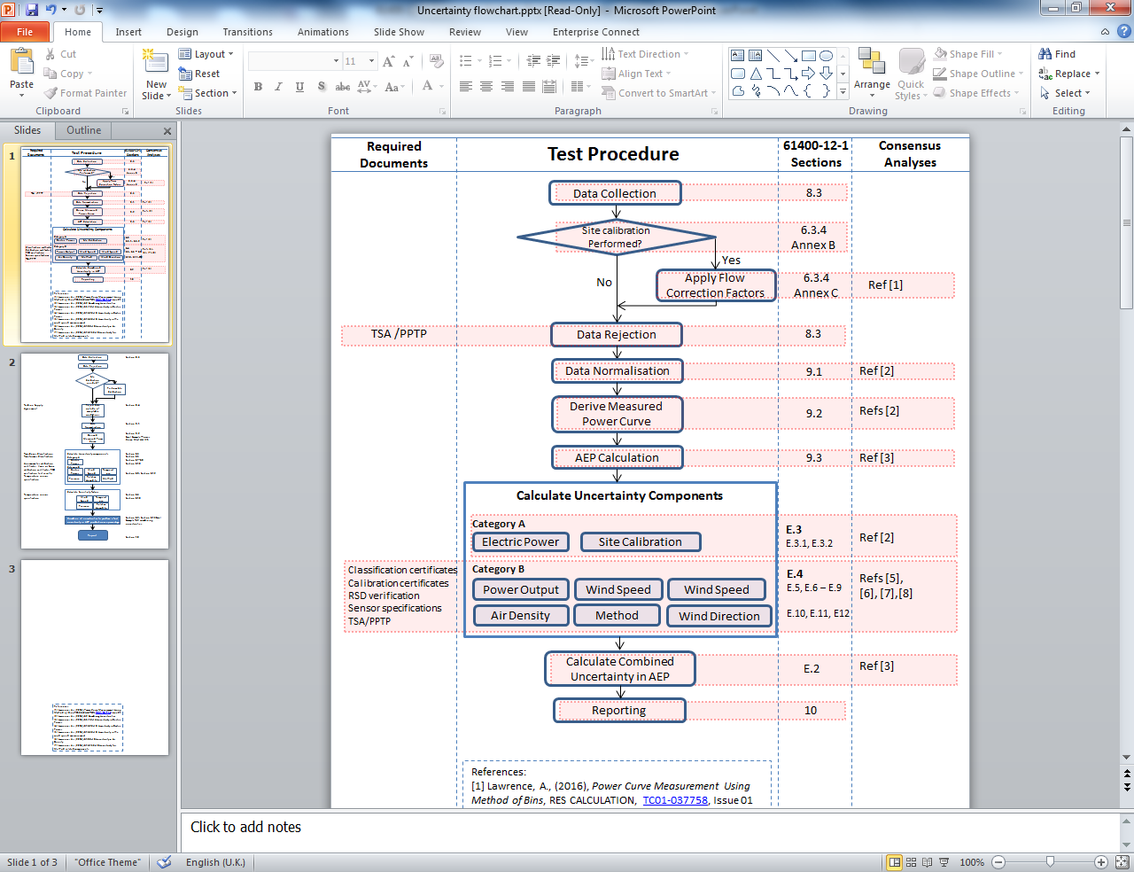
Power Performance Test Procedure

Slide 8
Industrial Project Aim
In this project we aim to demonstrate the proper implementation of the new IEC power performance testing standard, with focus on the uncertainty calculation.
We aim to do this by creating a collection of Excel spreadsheet calculations for key sections.
The calculations will be modular in structure, each showing the method for a small section.

Slide 9
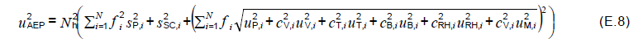
Power Curve Uncertainty Calculations
Uncertainty combination
Equation E.8 in the standard gives the method for combining separate uncertainty contributions to give overall uncertainty
This is the AEP uncertainty. It is what we need to calculate!

Slide 10
Power Curve Uncertainty Calculations
Uncertainty combination
Equation E.8 in the standard gives the method for combining separate uncertainty contributions to give overall uncertainty
Hours in a year. This turns our uncertainty in power into and uncertainty in energy

Slide 11
Power Curve Uncertainty Calculations
Uncertainty combination
Equation E.8 in the standard gives the method for combining separate uncertainty contributions to give overall uncertainty
Many components vary with wind speed so the combination is performed across all bins of the power curve

Slide 12
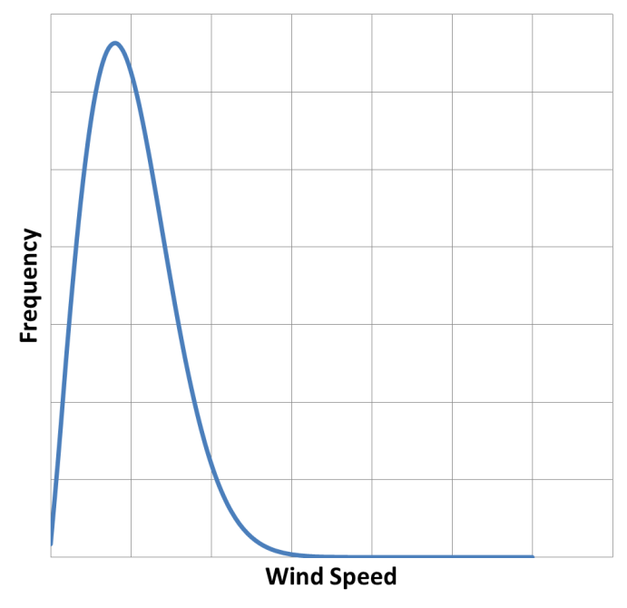
Power Curve Uncertainty Calculations
Uncertainty combination
Equation E.8 in the standard gives the method for combining separate uncertainty contributions to give overall uncertainty
Relative occurrence of each wind speed bin (to account for long term wind speed distribution)

Slide 13
Power Curve Uncertainty Calculations
Uncertainty combination
Equation E.8 in the standard gives the method for combining separate uncertainty contributions to give overall uncertainty
Category A uncertainties
Statistical uncertainties, based on the data. Due to statistical scatter, do not account for potential bias.
Category B uncertainties
To reflect potential bias in instrumentation and due to methodology.

Slide 14
Power Curve Uncertainty Calculations
Uncertainty combination
Equation E.8 in the standard gives the method for combining separate uncertainty contributions to give overall uncertainty
Category A uncertainties
Statistical uncertainties, based on the data. Due to statistical scatter, do not account for potential bias.
Category B uncertainties
To reflect potential bias in instrumentation and due to methodology.
We have a made spreadsheet demonstrating the calculation of each category A and B uncertainty component

Slide 15
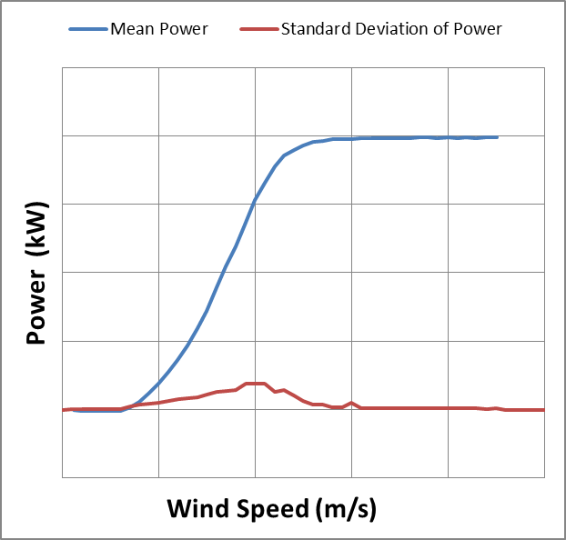
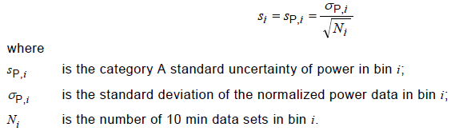
Power Curve Uncertainty Calculations
Category A - Power
“Power Curve Measurement Using The Method of Bins.xlsx”
Simple and well understood
Related to the standard deviation in each power curve bin

Slide 16
Power Curve Uncertainty Calculations
Category A - Site Calibration
“Site Calibration Using Linear Regression.xlsx”
New in this issue of the standard
Based on “K-Fold Analysis”:
Break the site calibration filtered dataset into 10 subsets (“folds”)
Predict turbine mast wind speed for each subset using the calibration data from the other 9 folds
Uncertainty is based on the standard deviation of prediction error in each fold

Slide 17
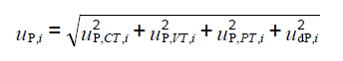
Power Curve Uncertainty Calculations
Category B - Power
“E.5 Category B Uncertainty in Electric Power.xlsx”
Uncertainties due to:
Current and voltage transformers
Power transducer
Data acquisition
Depends on the classification of voltage and current transformers
IEC 60044-1 gives uncertainties for different class of current transformers
IEC 60688-1 gives uncertainties for different class power transducers

Slide 18
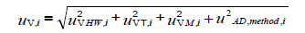
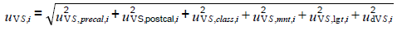
Power Curve Uncertainty Calculations
Category B – Wind Speed
“due to hardware used”, i.e. WS measurement instrumentation
For cup or sonic anemometer:
Components due to:
Pre-test calibration,
post-test calibration
Classification
Mounting
Lightning Finial
Data acquisition system
Notes:
REWS is not a piece of hardware, rather it is a definition of wind speed measurement. You can measure this using either mast or RSD in theory, although only RSD is practical.

Slide 19
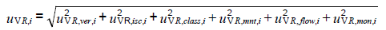
Power Curve Uncertainty Calculations
Category B – Wind Speed
“due to hardware used”, i.e. WS measurement instrumentation
For RSD:
Components due to:
Verification test vs mast
In-situ comparison to mast
RSD classification
Mounting
Flow variation in the measurement volume
Monitoring of the RSD
Notes:
REWS is not a piece of hardware, rather it is a definition of wind speed measurement. You can measure this using either mast or RSD in theory, although only RSD is practical.

Slide 20
Power Curve Uncertainty Calculations
Category B – Wind Speed
Uncertainties due to:
Hardware used
"E.13.4 Category B uncertainty in wind speed from cup or sonic.xlsx"
"E.13.5 Category B uncertainty in wind speed from RSD.xlsx"
"E.13.6 Category B uncertainty in wind speed from REWS.xlsx"
Note that REWS can in theory be measured with mast or RSD, in reality only RSD is practical
Terrain
"E.13.11 Category B uncertainty in wind speed from flow distortion due to terrain.xlsx“
Related to the site calibration (or lack thereof)
Air Density Correction
"E.10 Category B uncertainty in Air Density.xlsx"
Related to air density correction
`
"E.13.3 Category B Uncertainty in the Wind Speed Measurement.xlsx"
Notes:
REWS is not a piece of hardware, rather it is a definition of wind speed measurement. You can measure this using either mast or RSD in theory, although only RSD is practical.

Slide 21
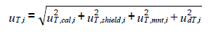
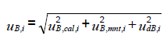
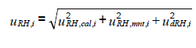
Power Curve Uncertainty Calculations
Category B – Temperature, Pressure and Relative Humidity
"E.10 Category B uncertainty in Air Density.xlsx"
Relative humidity was not included in the previous standard
Same components, but sensitivity factor has changed in this issue of the standard
All informed by manufacturer specs with extra penalties if measurement is far from hub height
Temperature:
Calibration
Shielding
Mounting
Data acquisition
Pressure:
Calibration
Mounting
Data acquisition
Relative Humidity:
Calibration
Mounting
Data acquisition

Slide 22
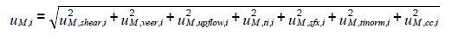
Power Curve Uncertainty Calculations
Category B – Method related components
"E.13.15 Category B Uncertainty Calculation for Method related components.xlsx"
Many new sub-components in this issue of the standard
Uncertainties due to:
Uncertainty in calculation of wind shear & veer
Uncertainty due to lack of knowledge of upflow angle & turbulence
Uncertainty due to unquantifiable seasonal effects
Uncertainty due to cold climate
Uncertainty due to turbulence normalisation

Slide 23
Power Performance Analysis Procedure

Slide 24
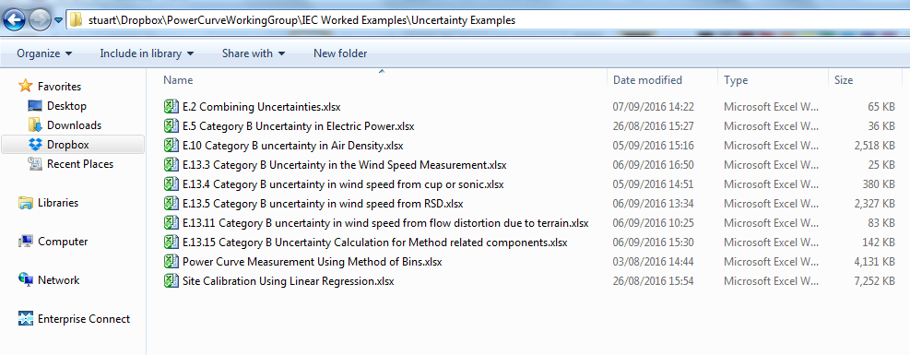
REFERENCES
[1] Lawrence, A., (2016), Power Curve Measurement Using Method of Bins, RES CALCULATION, TC01-037758, Issue 01
[2] Lawrence, A., (2016), Site Calibration Using Linear Regression
[3] Lawrence, A., (2016), E.5 Category B Uncertainty in Electric Power
[4] Lawrence, A., (2016), E.13.3 Category B Uncertainty in the wind speed measurement
[5] Lawrence, A., (2016), E.10 Category B Uncertainty in Air Density
[6] Lawrence, A., (2016), E.13.15 Category B Uncertainty for Method related components
PCWG Drop Box Folder

Slide 25
Join the Power Curve Working Group at: www.pcwg.org

